Slide 1
Instructions for Assigning Papers to Session Chairs
- Program Chair

Slide 2
Outline
Account Login [Slide 3]
Assign papers to session chairs. [Slide 9]
Update Session Chair Names for Paper Assignment [Slide 11]

Slide 3
Account Login (A)
Login Site
https://www.easychair.org/account/signin
Account:
UV Assistant
Username: session1.assistant@universal-village.org
Password: u…v…
Session Chair account list
Example
Username: TS1-A@ieeeuv.onmicrosoft.com
Password: u…v…

Slide 4
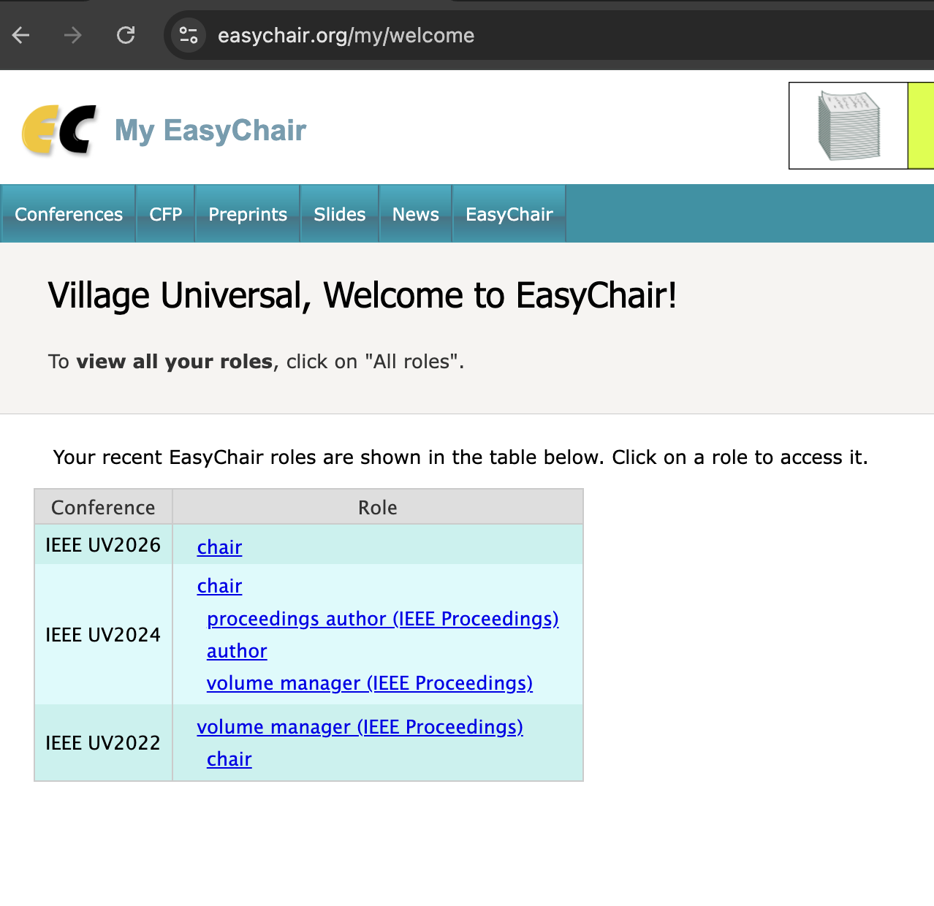
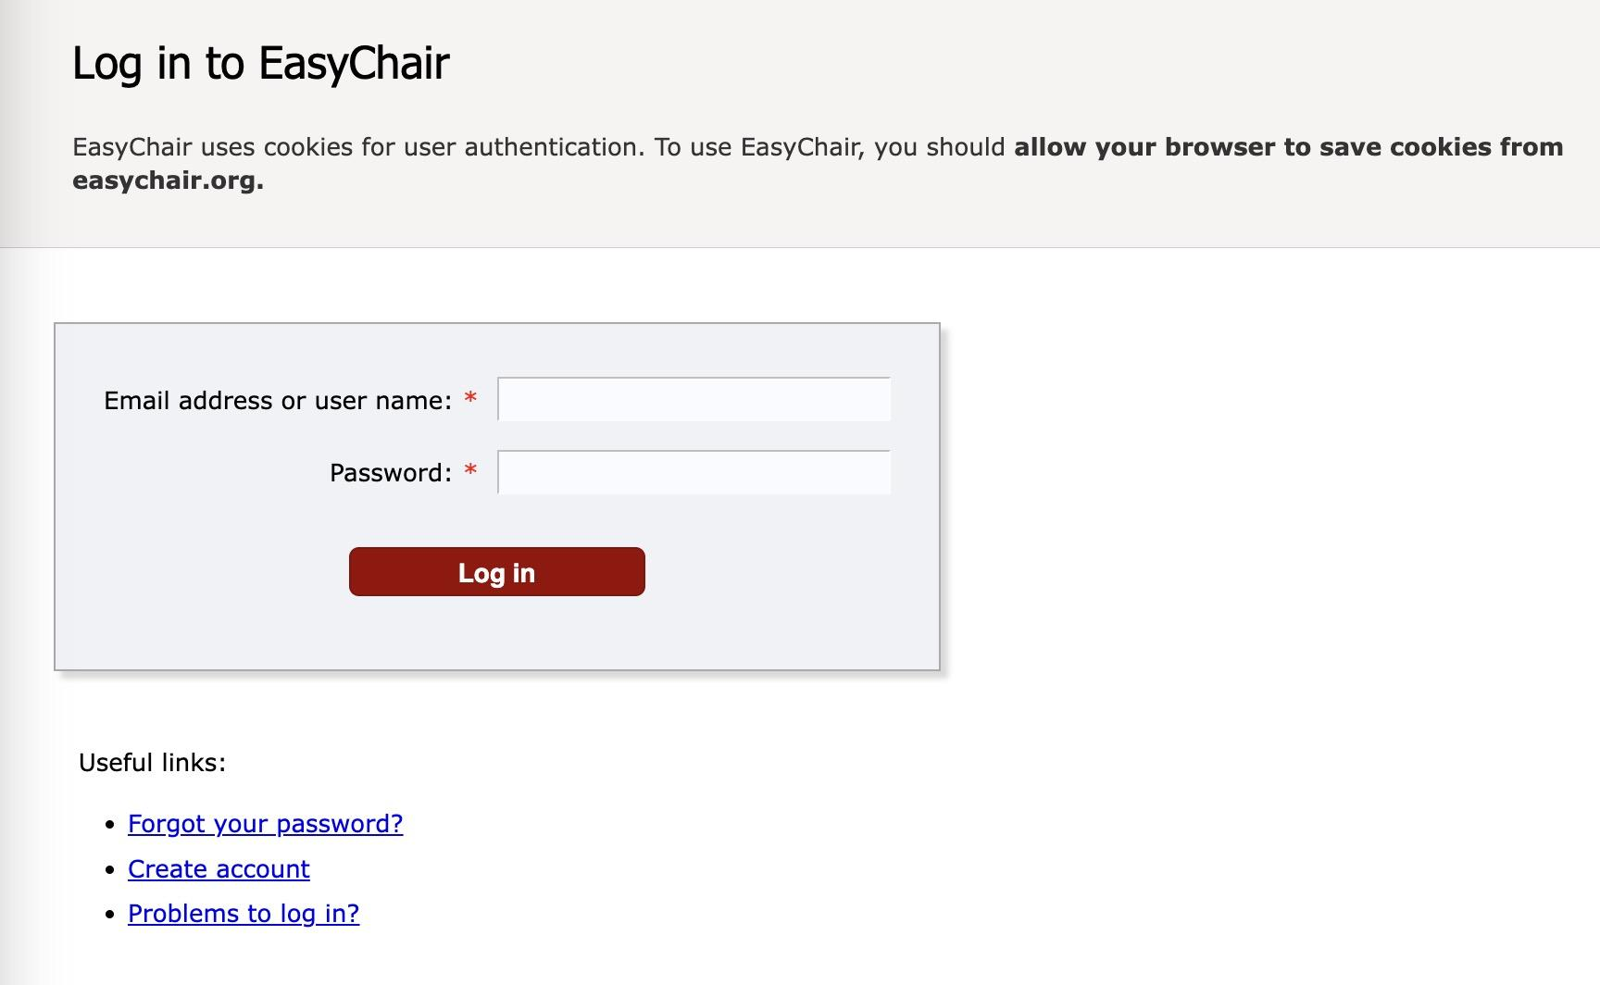
Account Login (B)

Slide 5
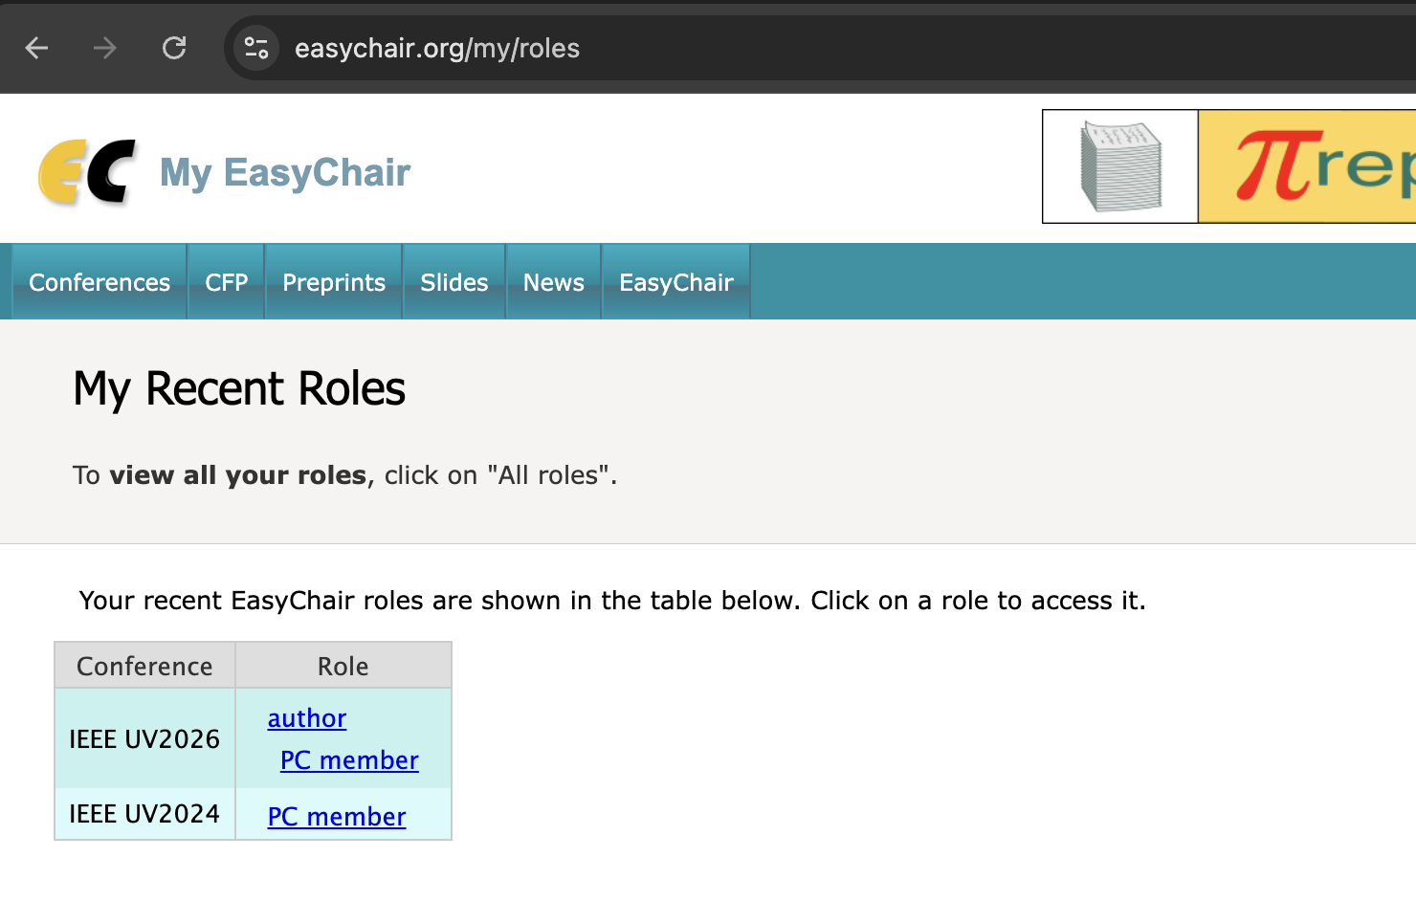

Account Login (C)
Click the option “PC member”

Slide 6

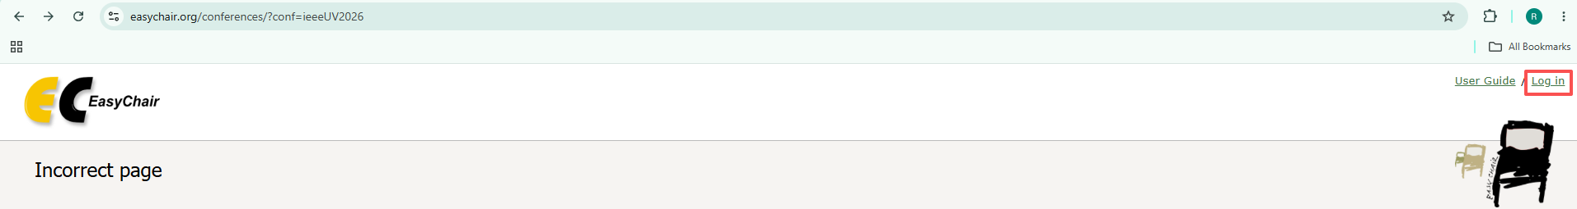
Account login (D)
Please make sure that you are logged in to EasyChair before accessing the IEEE UV2026 conference page (https://easychair.org/conferences/?conf=ieeeUV2026).
Otherwise, you may encounter the following error message.
Please click the “Log in” on the top right corner AND enter your account and password to log in.

Slide 7

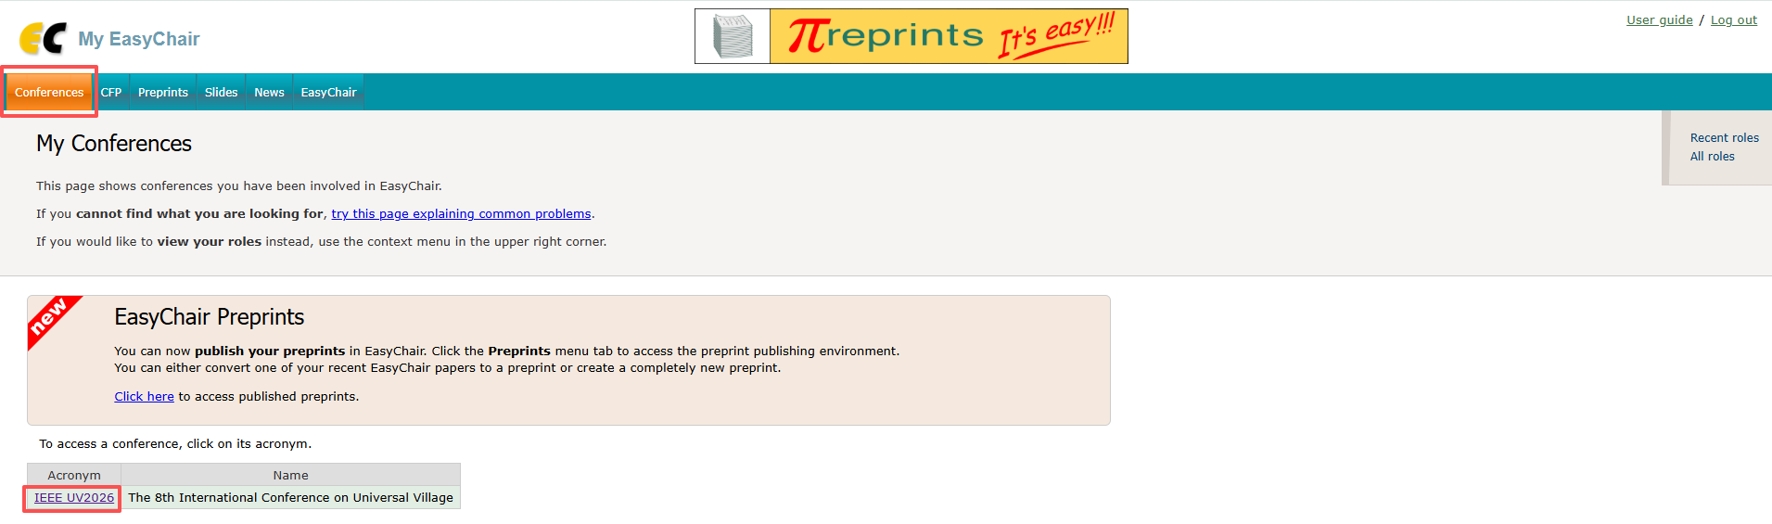

Account login (E)
b) After logging in, click on “Conferences” and then “IEEE UV2026” to access UV2026 Publication System

Slide 8
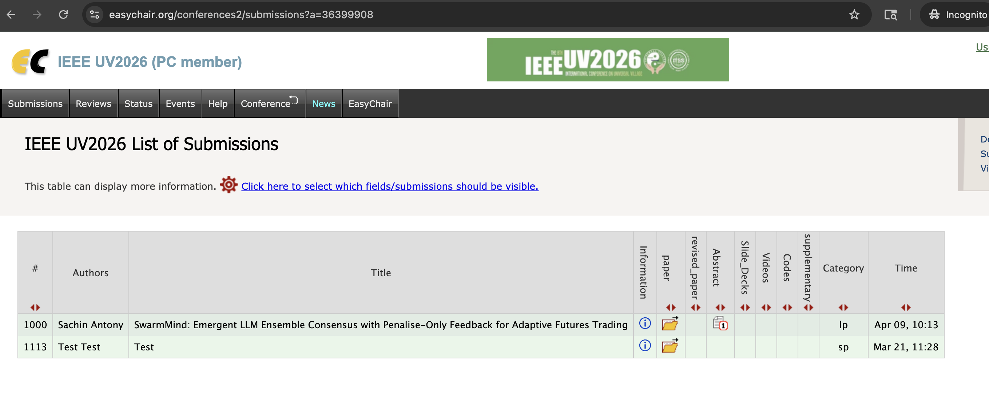
Click the option “Time” to check for the most recent submission

Slide 9
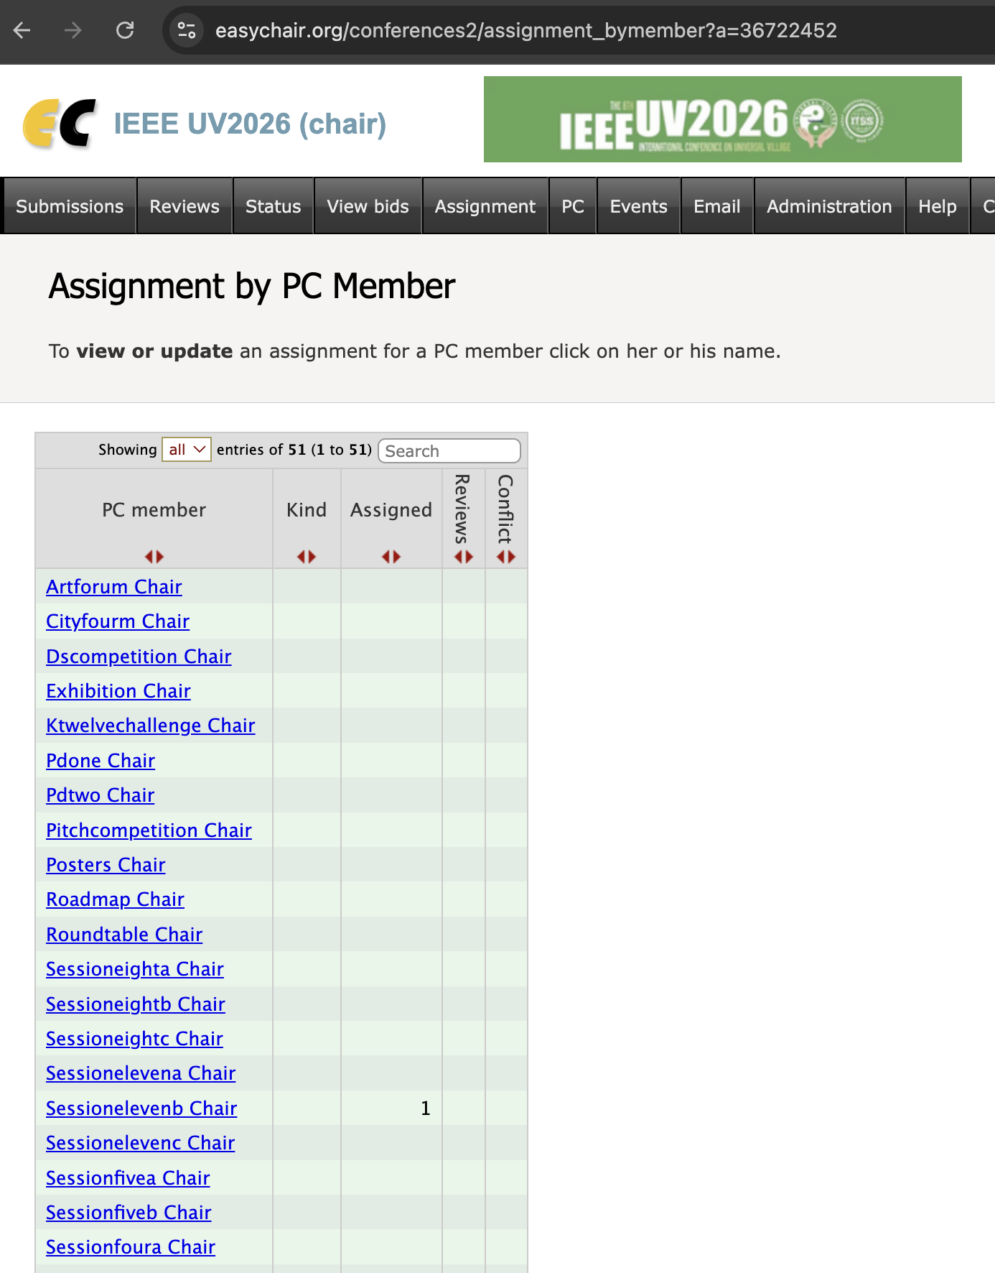

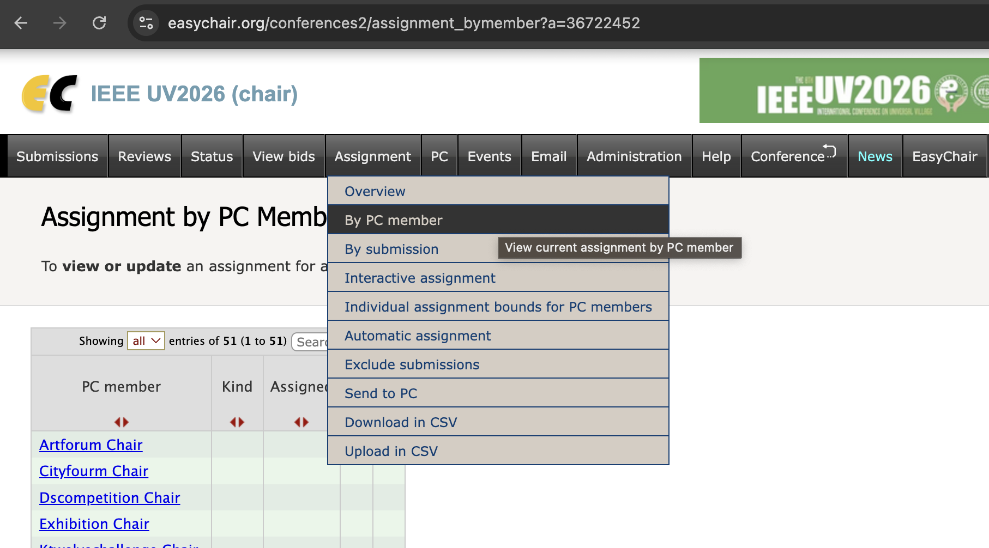


2. Paper Assignment (A)
After clicking “Assignment” and then “by PC Member”, you will be able to review current assignment of papers.

Slide 10
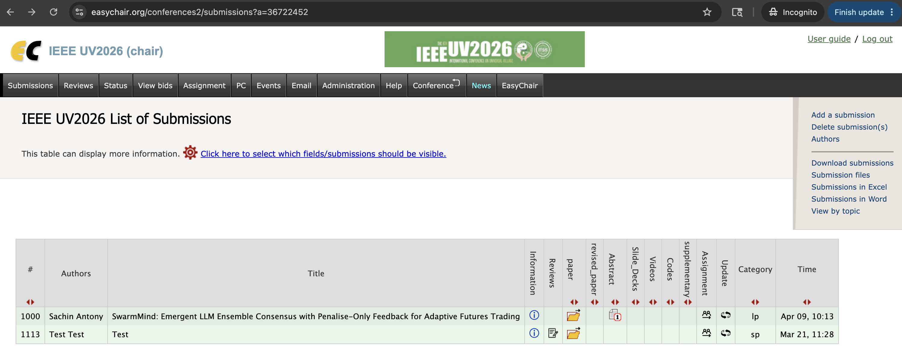


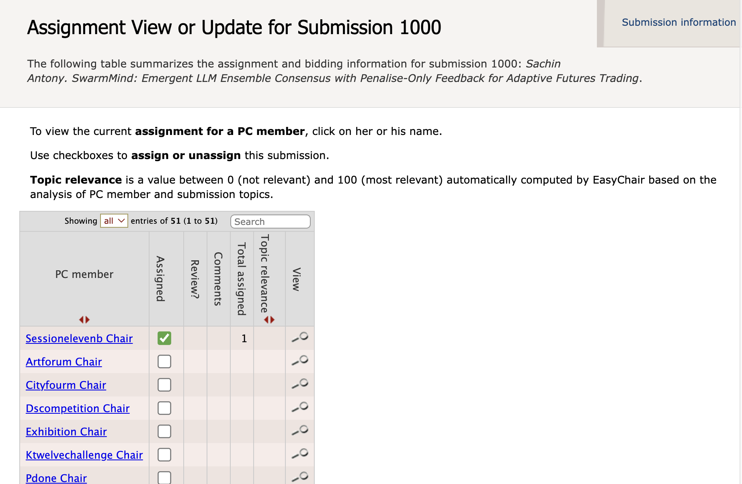


2. Paper Assignment (B)
Step 1: Click the “Submissions” tab, Click the button in the “Assignment” column for the paper.
You will then be redirected to “Assignment View or Update for Submission” page.
Step 2: To complete the assignment, check the box in the “Assigned” column for the corresponding PC member.

Slide 11
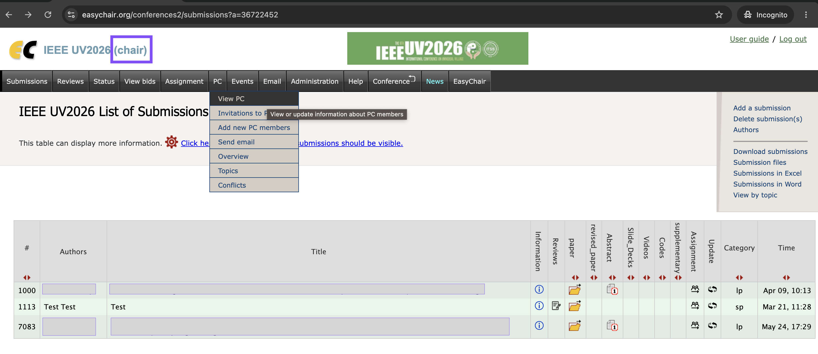
3. Update Session Chair Names for Paper Assignment(A)
Click “PC” -> “View PC”; Now, you will be able to see all the PC members.

Slide 12

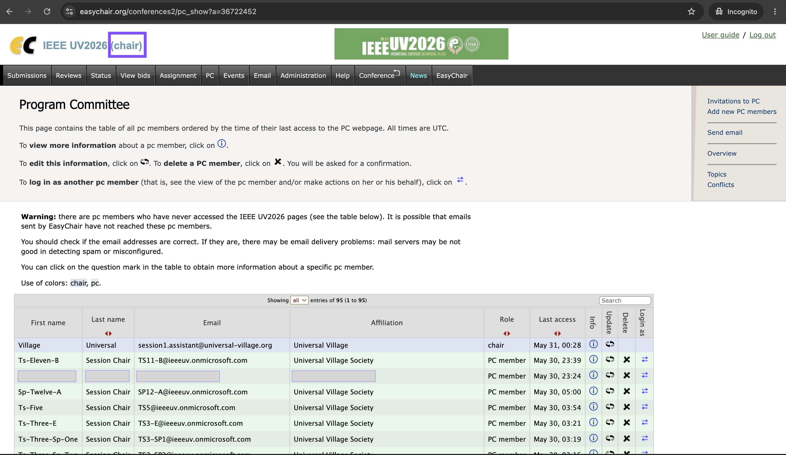
3. Update Session Chair Names for Paper Assignment(B)
Click under “Update” to edit a PC member's information.

Slide 13
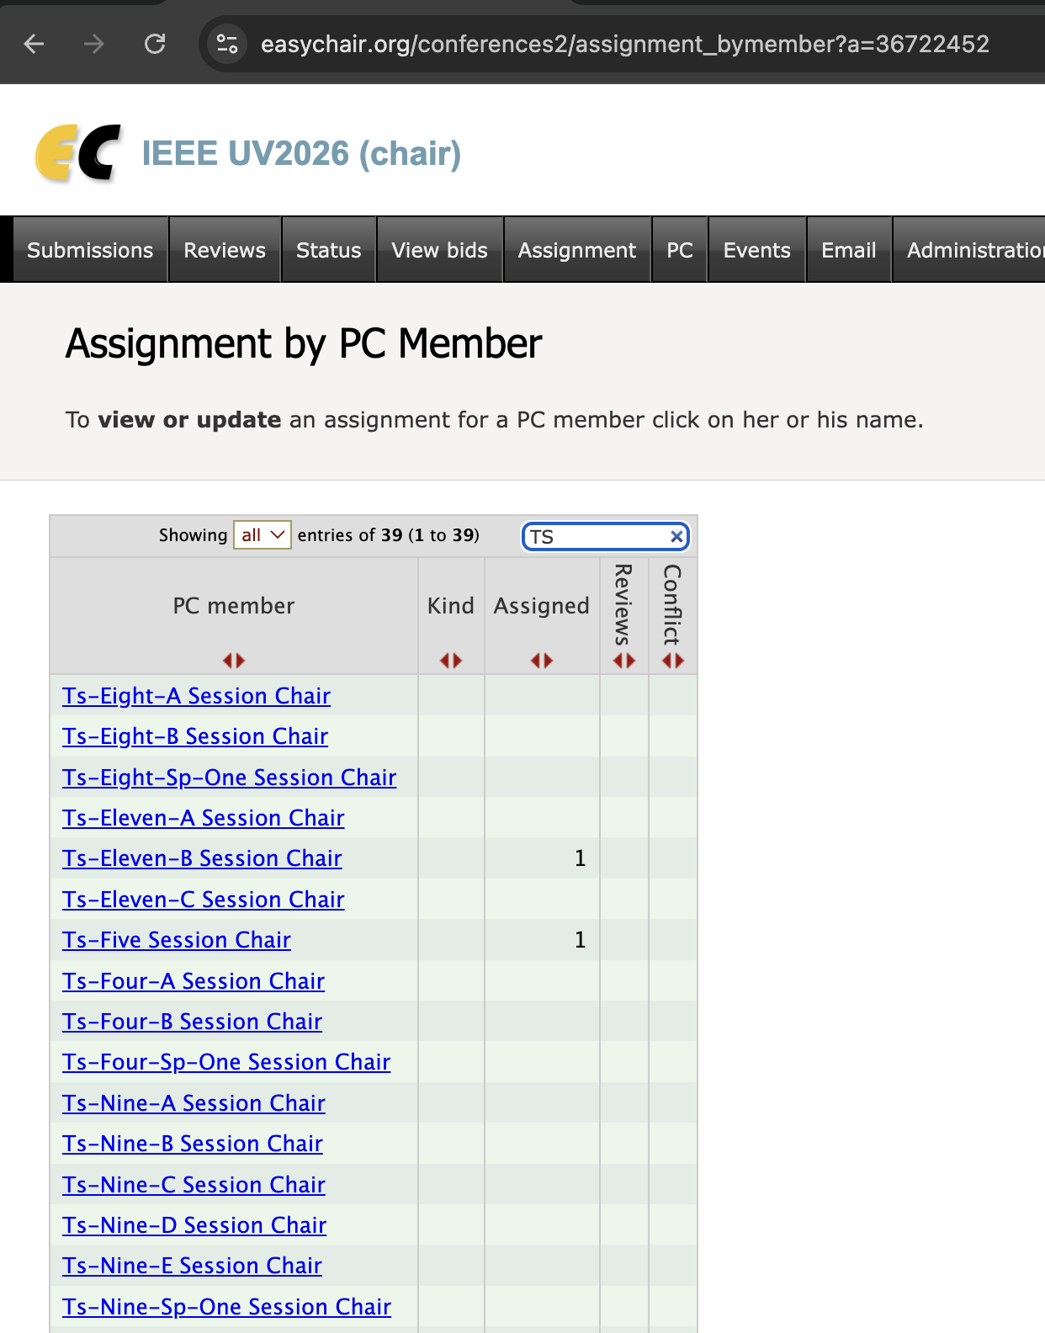
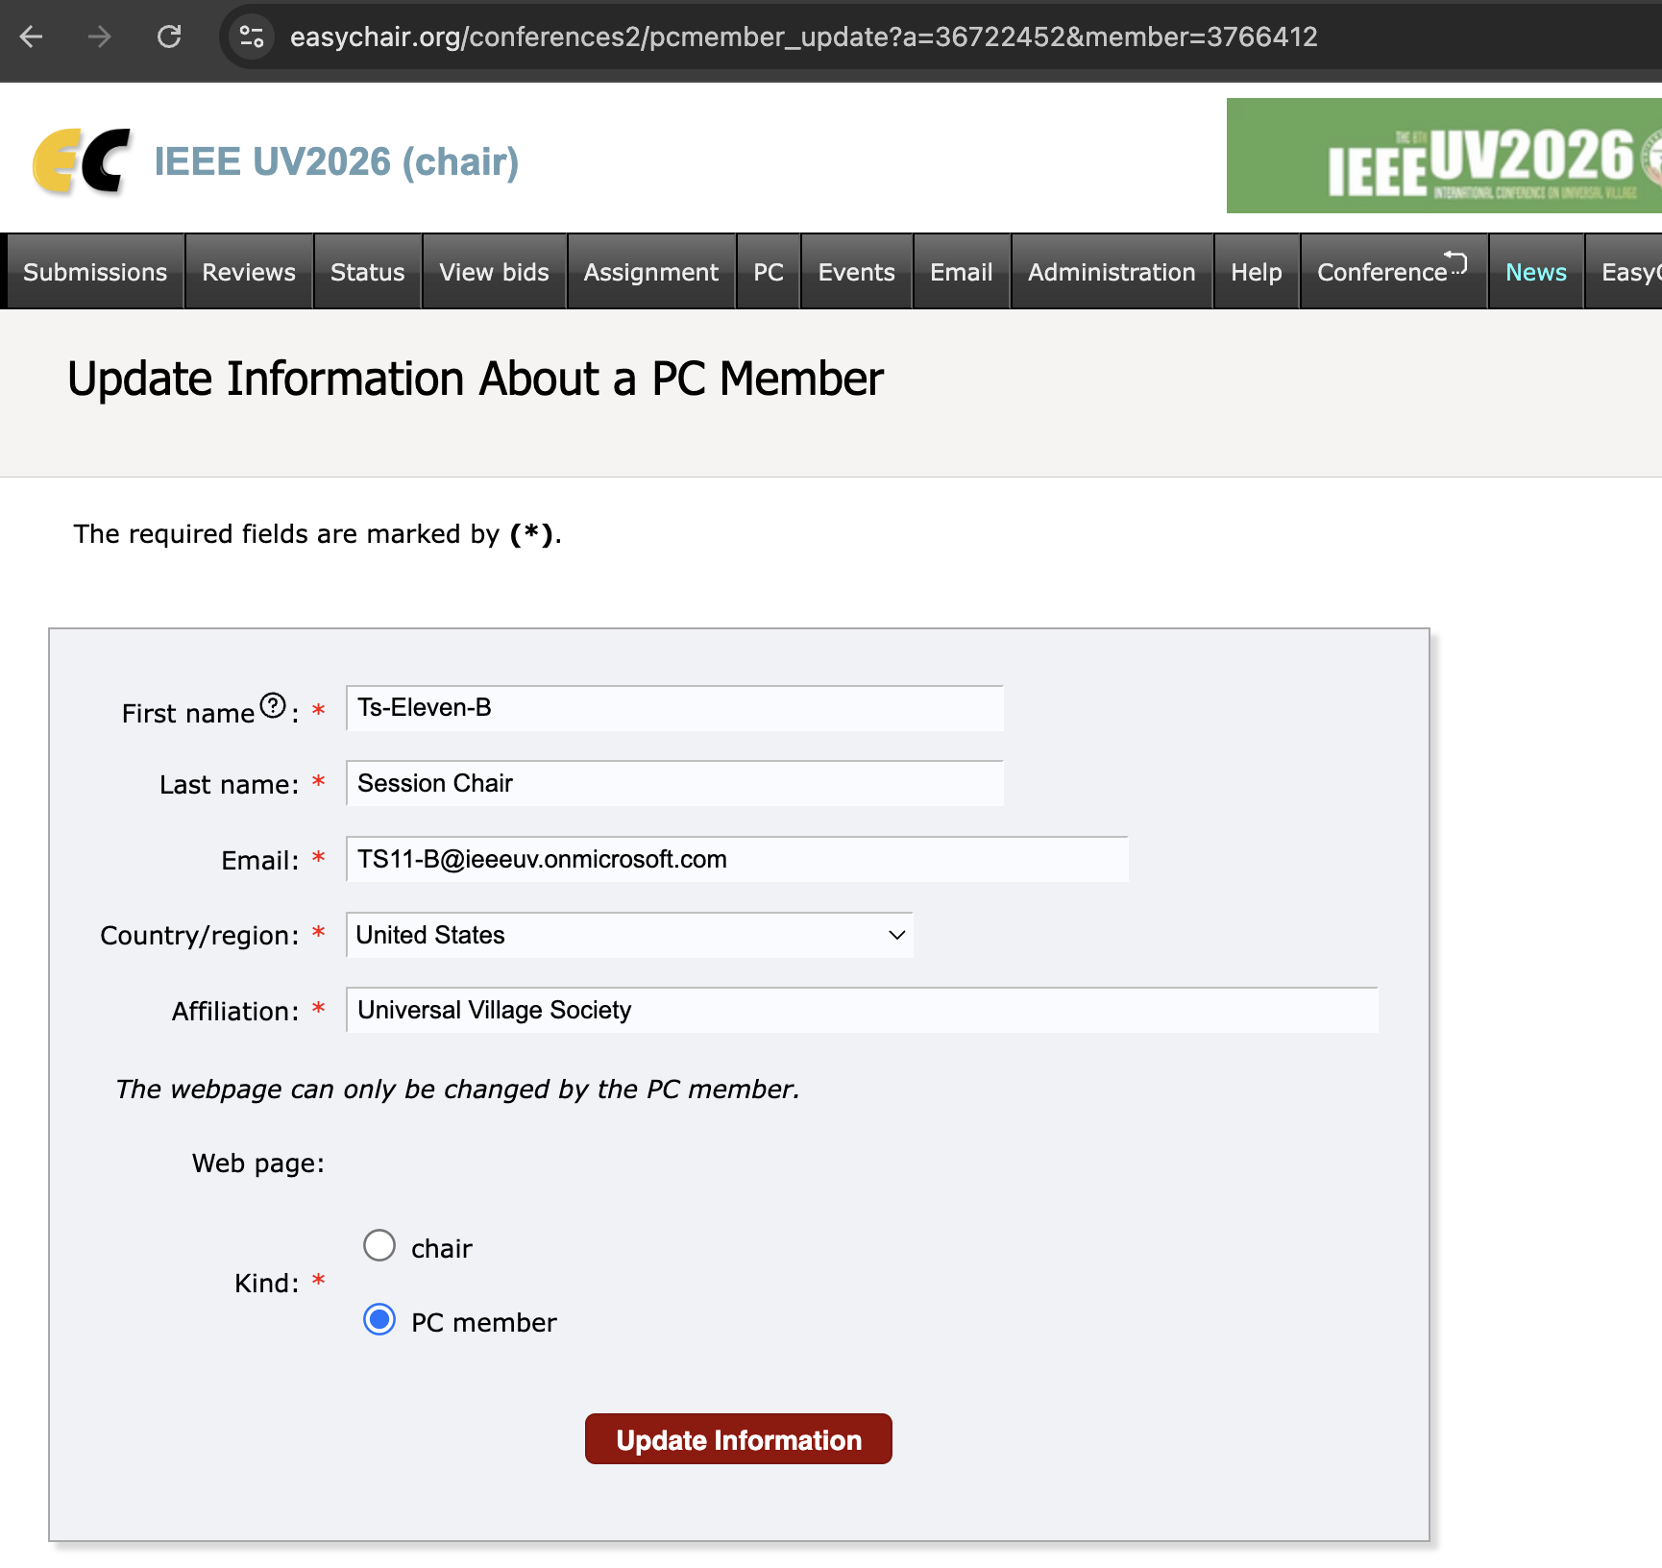

3. Update Session Chair Names for Paper Assignment(C)
This name will appear in the "PC Member" column and will be used to identify the corresponding Session Chair during paper assignment.

